Slide 1
Motion Models

Slide 2
Objectives
What is image stitching ?
Understand about motion models.
Study some motion model such as Planar perspective motion, Rotational panoramas, Gap closing, Cylindrical and spherical coordinates
Applications of motion models

Slide 3
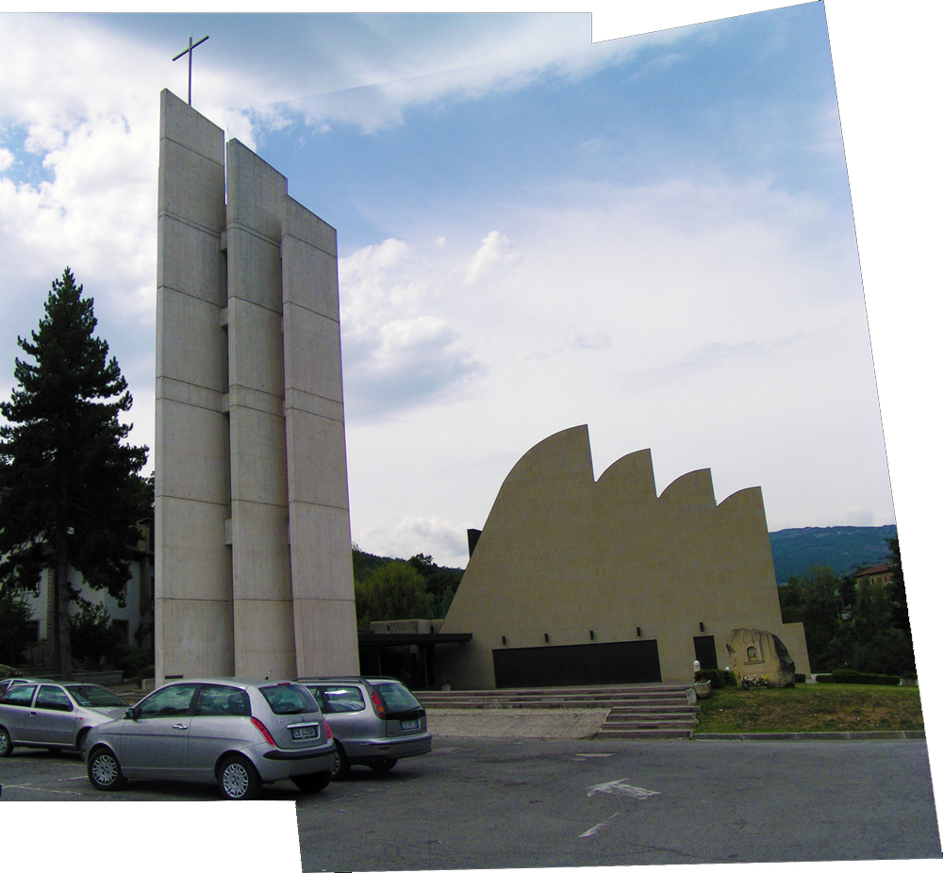
What is image stitching?
1 or 2 images ?
Any stitching application do you know ?

Slide 4
Image stitching
Image stitching is the process of combining multiple photographic images with overlapping fields of view to produce a segmented panorama or high-resolution image.
Image stitching is a widely used technique for recovering original data from ripped data.
Image stitching is used in forensic and investigative science for the reconstruction of torn paper which is a big problem.
In image mapping, stitching of images is done to do the complete mapping of a particular place.

Slide 5
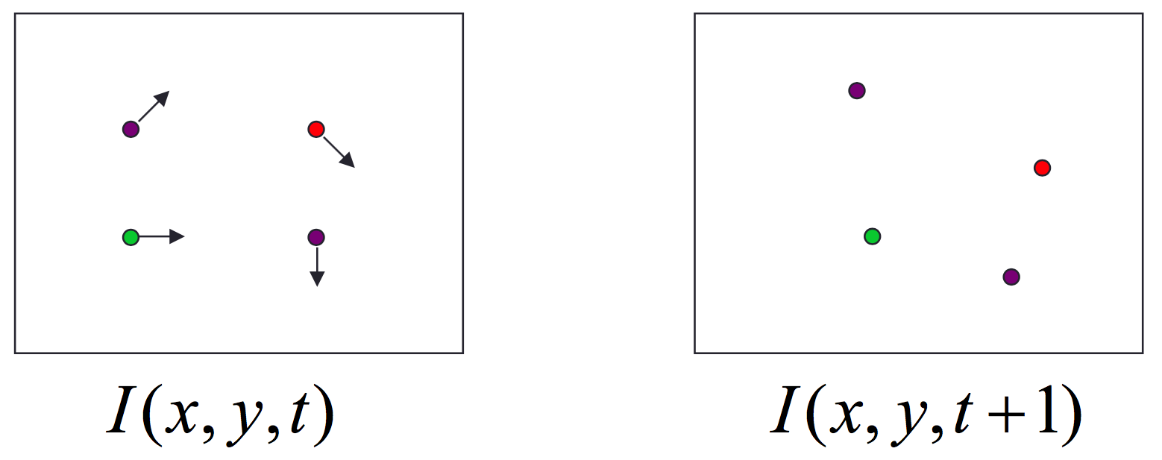
Motion
How to estimate pixel motion from image I(x,y,t) to I(x,y,t+1) ?•
Solve pixel correspondence problem– given a pixel in I(x,y,t), look for nearby pixels of the same color in I(x,y,t+1)
This is called the optical flow problem

Slide 6
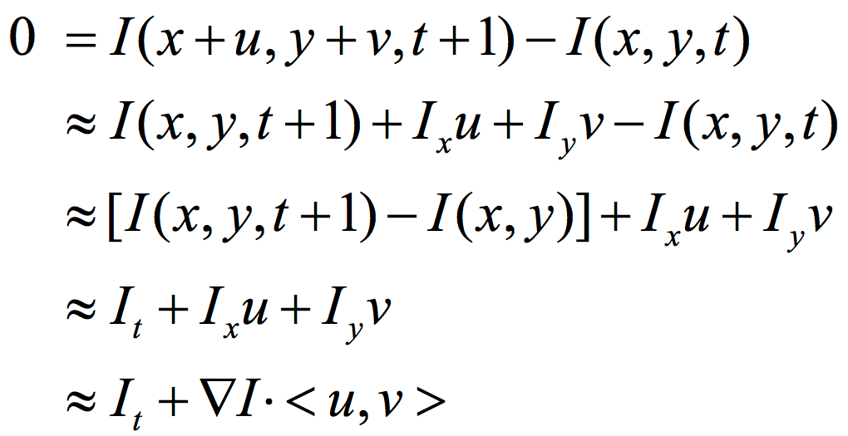

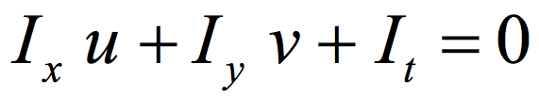
Optical flow problem
Intensity equation:
In the limit as u and v go to zero, this becomes exact
Brightness constancy constraint equation

Slide 7
Planar perspective motion
Aligning images is to simply translate and rotate them in 2D
This is exactly the same kind of motion that you would use if you had overlapping photographic prints.
The perspective transformation deals with the conversion of 3d world into 2d image.

Slide 8
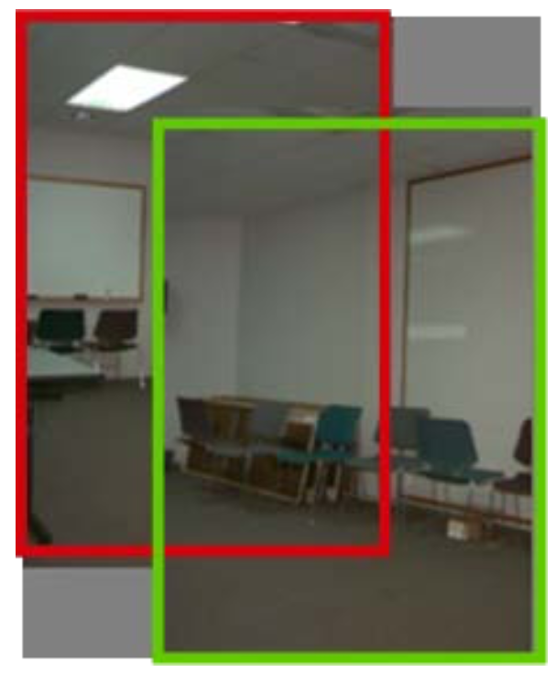
Planar perspective motion

Slide 9
Application: Whiteboard and document scanning
The most obvious application is used in scanning large documents - beyond the size of the scanner--> so what is the solution?
We simply use multiple scanners, scan parts of the document, and then stitching them together.
Note that the component images must overlap with amount enough so as not to miss any feature of the other large document.

Slide 10
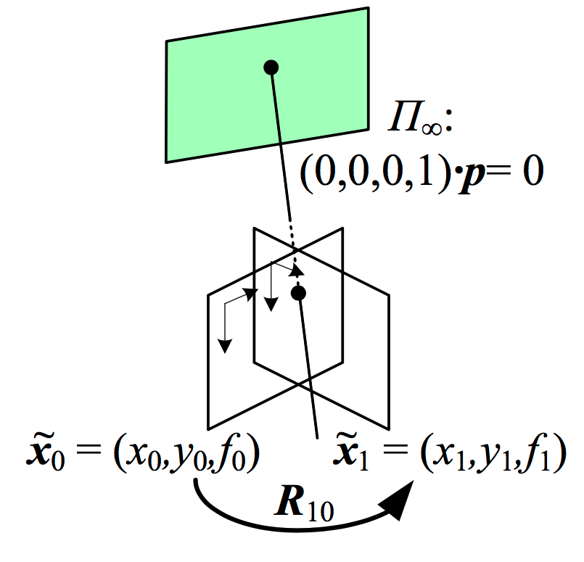
Rotational panoramas
Assume the camera is doing pure 3D rotation
The most common panoramic image stitching, e.g., when taking images of the Grand Canyon
Assumes that all points are very far from the camera

Slide 11

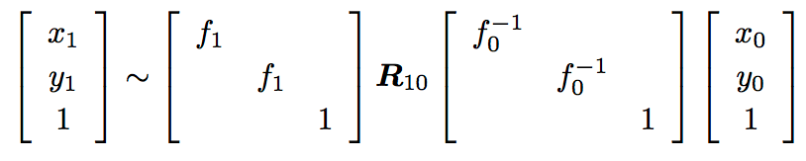
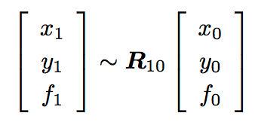
Rotational panoramas
In this case simplified homography
Where K the camera intrinsic matrix assuming cx = cy = 0
This can be written as
Or more explicily

Slide 12
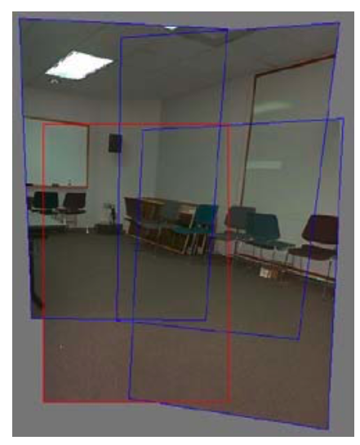
Rotational panoramas
Four images taken with a hand-held camera registered using a 3D rotation motion model

Slide 13
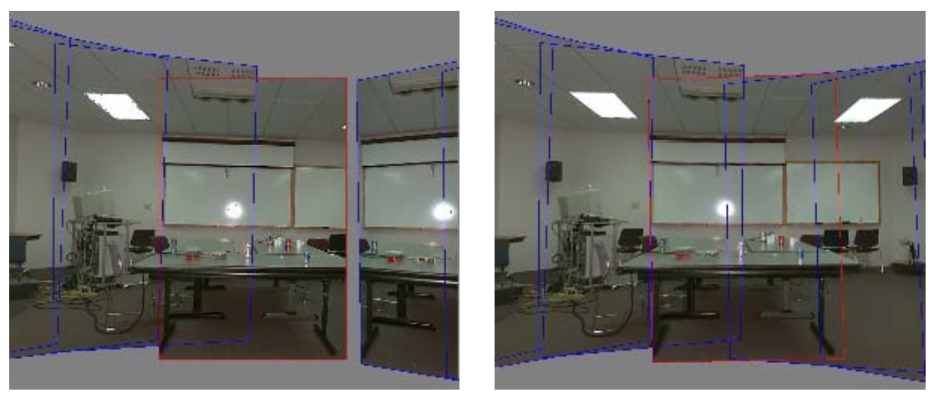
Gap closing
A gap is visible when the focal length is wrong (f = 510).
No gap is visible for the correct focal length (f = 468).

Slide 14
Cylindrical and Spherical Coordinates
An alternative to using homographies or 3D motions to align images is to first warp the images into cylindrical coordinates and then use a pure translational model to align them
This only works if the images are all taken with a level camera or with a known tilt angle.
Assume for now that the camera is in its canonical position, i.e., R = I and the optical axis is aligned with the z axis and the y axis is aligned vertically
We wish to project this image onto a cylindrical surface of unit radius
Points on this surface are parameterized by an angle θ and a height h with the 3D cylindrical given by (sin θ, h, cos θ) ∝ (x, y, f )

Slide 15
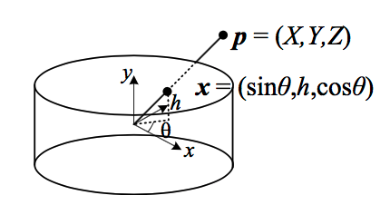
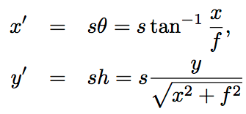
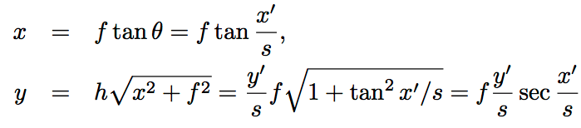
Cylindrical and Spherical Coordinates
We can compute the correspondence between warped and mapped coordinates

Slide 16
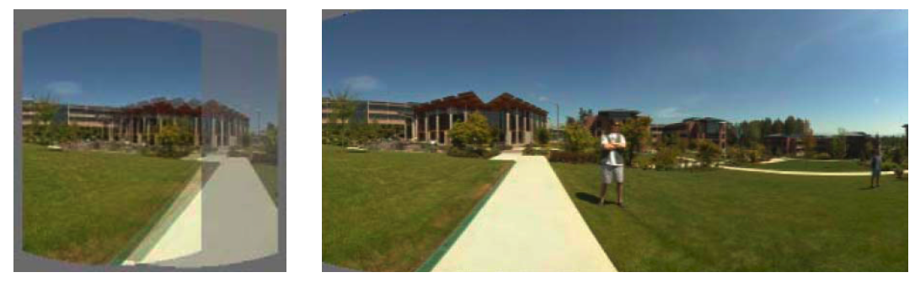
Cylindrical Panorama
Cylindrical is used if the camera is level and we have only rotation around its vertical axis
Then we only need to estimate a translation

Slide 17
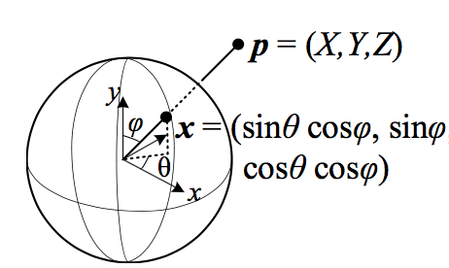
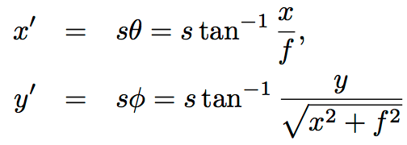
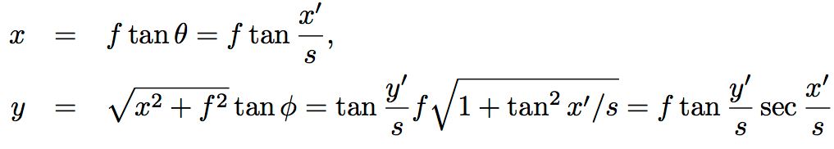
Spherical Projection
while the inverse is given by

Slide 18
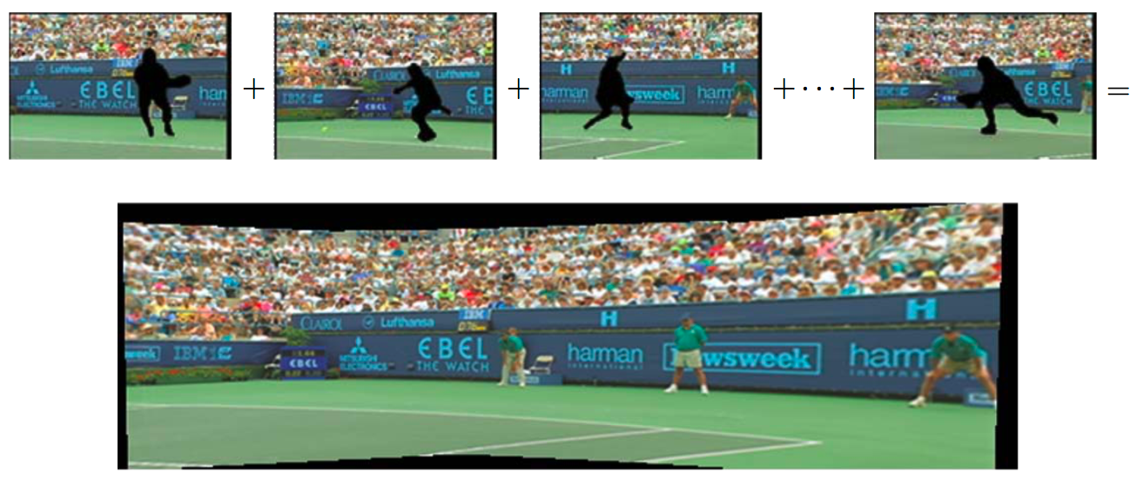
Application: Video summarization and compression
Video stitching the background scene to create a single sprite image that can be transmitted and used to re-create the background in each frame

Slide 19
Summary
What is image stitching ?
Understand about motion models.
Study some motion model such as Planar perspective motion, Rotational panoramas, Gap closing, Cylindrical and spherical coordinates
Applications of motion models

